Slide 1


Guideline for reviewers and Biostat

Slide 2
Access
Setup trial for PK review
Trial info
Superusers vs. users
Upload PK data
Review tool
The display
Select and zoom
Using the tool
Selectable profiles and ordering
Review progress
The main view
Exploration of tail fit
Plot options
Profile comments
Creating minutes
Download trial data
Delete trial
Content

Slide 3
Access

Slide 4
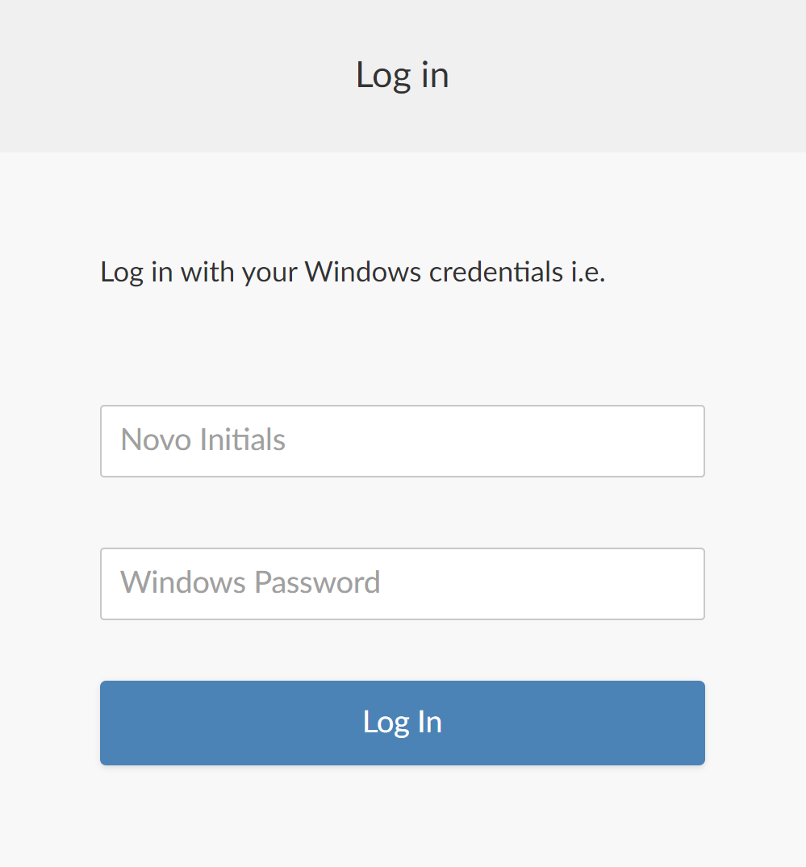
Access
Access the tool by writing ‘pkpdreview/’ in an Edge browser.
Login with your Novo Initials and Windows Password​

Slide 5
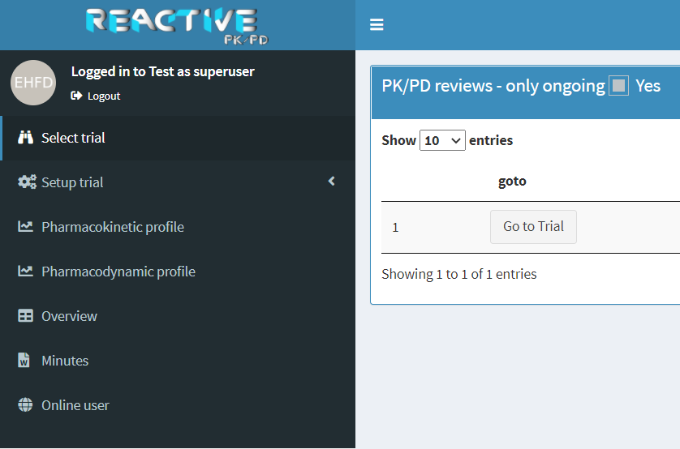
Starting point
Deselect ‘only ongoing’ to display all trials available for you
After gaining access you will either:
Be sent directly to a trial
If you currently have one trial in ongoing review
Have the option to choose which trial to go to
If you currently have more than one trial in ongoing review
Select ‘Go to Trial’ on the trial you wish to access
If you wish to change trial go to ‘Select trial’ in the menu bar

Slide 6
Setup trial for PK review

Slide 7
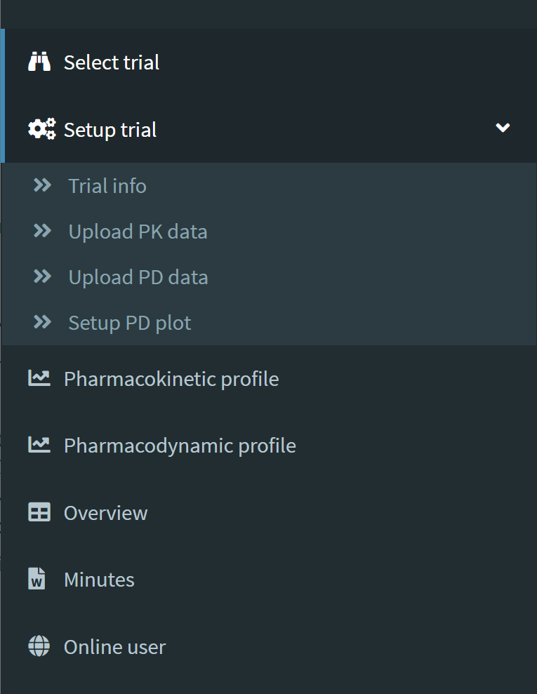
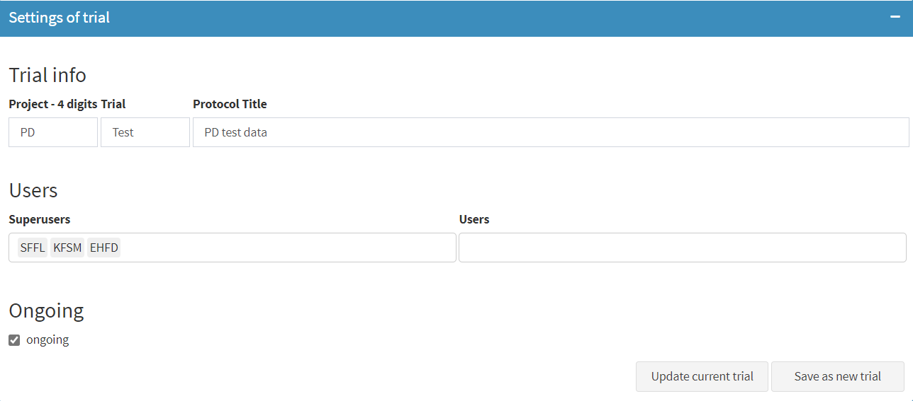
Trial info
Go to ‘Setup trial’ → ‘Trial info’ in the menu bar
Fill out the information regarding the trial:
projects four digits id
the trials four digits id
the protocol title
Specify the superusers and users.
It is recommended that only people within Biostat is included as superusers. For further details click here
When the trial information and superusers are specified click on ‘save as new trial’
This is only possible when all trial information and superusers are specified
Remember to click ‘Update current trial’ when changing any information
Notice that as a default the trial is set to ‘ongoing’

Slide 8
Superusers
Can upload and download trial data
Can update the status of comments
Has access to the advanced settings for a PK profile
Can edit and delete comments
Can create minutes
Can extract PK profiles and comments to document review
Can adjust trial settings in ‘Trial info’
Can delete trial
Users
Can view the PK profiles
Can add comments to specific data points
Can add comments to the whole profile
Can edit and delete own comments

Slide 9
Upload PK data

Slide 10
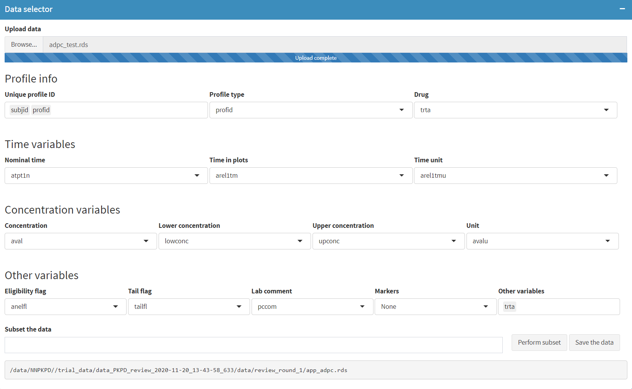
Profile info
Choose ‘Upload PK data’ in the menu bar
Specify variables of interest in ‘Data selector’
Click browse to upload either an R or SAS dataset in long format. It is recommended to use adam data.
‘Unique profile ID’
A combination of variables that identifies a unique PK profile. Hence, a type of subject identification should always be included, e.g. FSUBJID or SUBJID
It needs to stay constant throughout each data load since comments will be bound to it
‘Profile type’ and ‘Drug’
Optional variables that are used for alignment of axes and ordering of PK prifles
Set to ‘None’ if neither ordering or aligning is needed

Slide 11
Time variables
‘Nominal time’
Time variable reflecting the nominal time for each data point
It needs to stay constant throughout each data load since comments will be bound to it
‘Time in plots’
Time variable used when plotting each PK profile
This variable is used in tail fit estimation
Whether this should be nominal or actual time is trial specific
‘Time unit’
Unit of the variable selected in 'Time in plots'

Slide 12
Concentration variables
‘Concentration’
Variable consisting of the concentration values
‘Lower concentration’ and ‘Upper concentration’
Variables reflecting the lower and upper boundary for values below LLOQ and the concentration value elsewhere
In case the variables are unequal the data point will be identified as below LLOQ
In case the variables are unequal and the tail flag equals 'Y' the data point is included in the tail fit estimation as censored
Both can be set to be the same variable as selected under 'Concentration' in case identification of values below LLOQ is not needed
‘Unit’
Unit of the variable selected in 'Concentration'

Slide 13

Other variables
‘Eligibility flag’
Variable that equals 'Y' for eligible data points and blank elsewhere
‘Tail flag’
Variable that equals 'Y' for data points used in tail fit and blank elsewhere
‘Lab comment’
Variable containing comments from the lab
‘Markers’
Optional variable to add special markers in the plots
Different coloured circles will be used for each unique level of the variable
The levels of the variable will be used as legends for the circles
No markers will be made for a blank level
For example in case of a MD trial, trough values could be marked by selecting a variable that indicates 'Trough' for trough values and is blank elsewhere
‘Other variables’
Optional variable for subsetting the data.
‘Subset the data’
Subsettings is performed via an R statement
For example by choosing ‘trta’ as ‘Other variables’ and typing $trta==A$ the uploaded data will only contain data rows related to treatment A

Slide 14
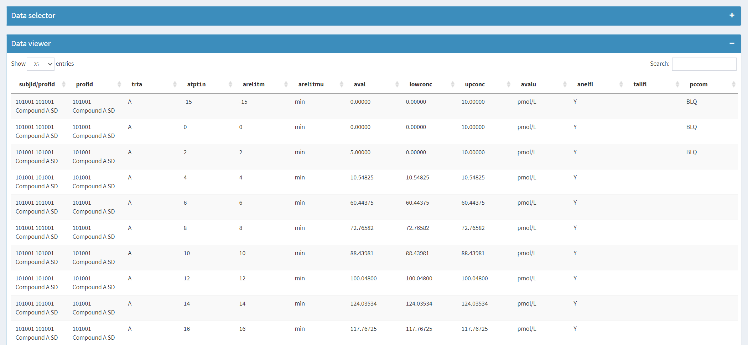
Data viewer
View the data, which will be uploaded to the tool in ‘Data viewer’

Slide 15
Review tool

Slide 16
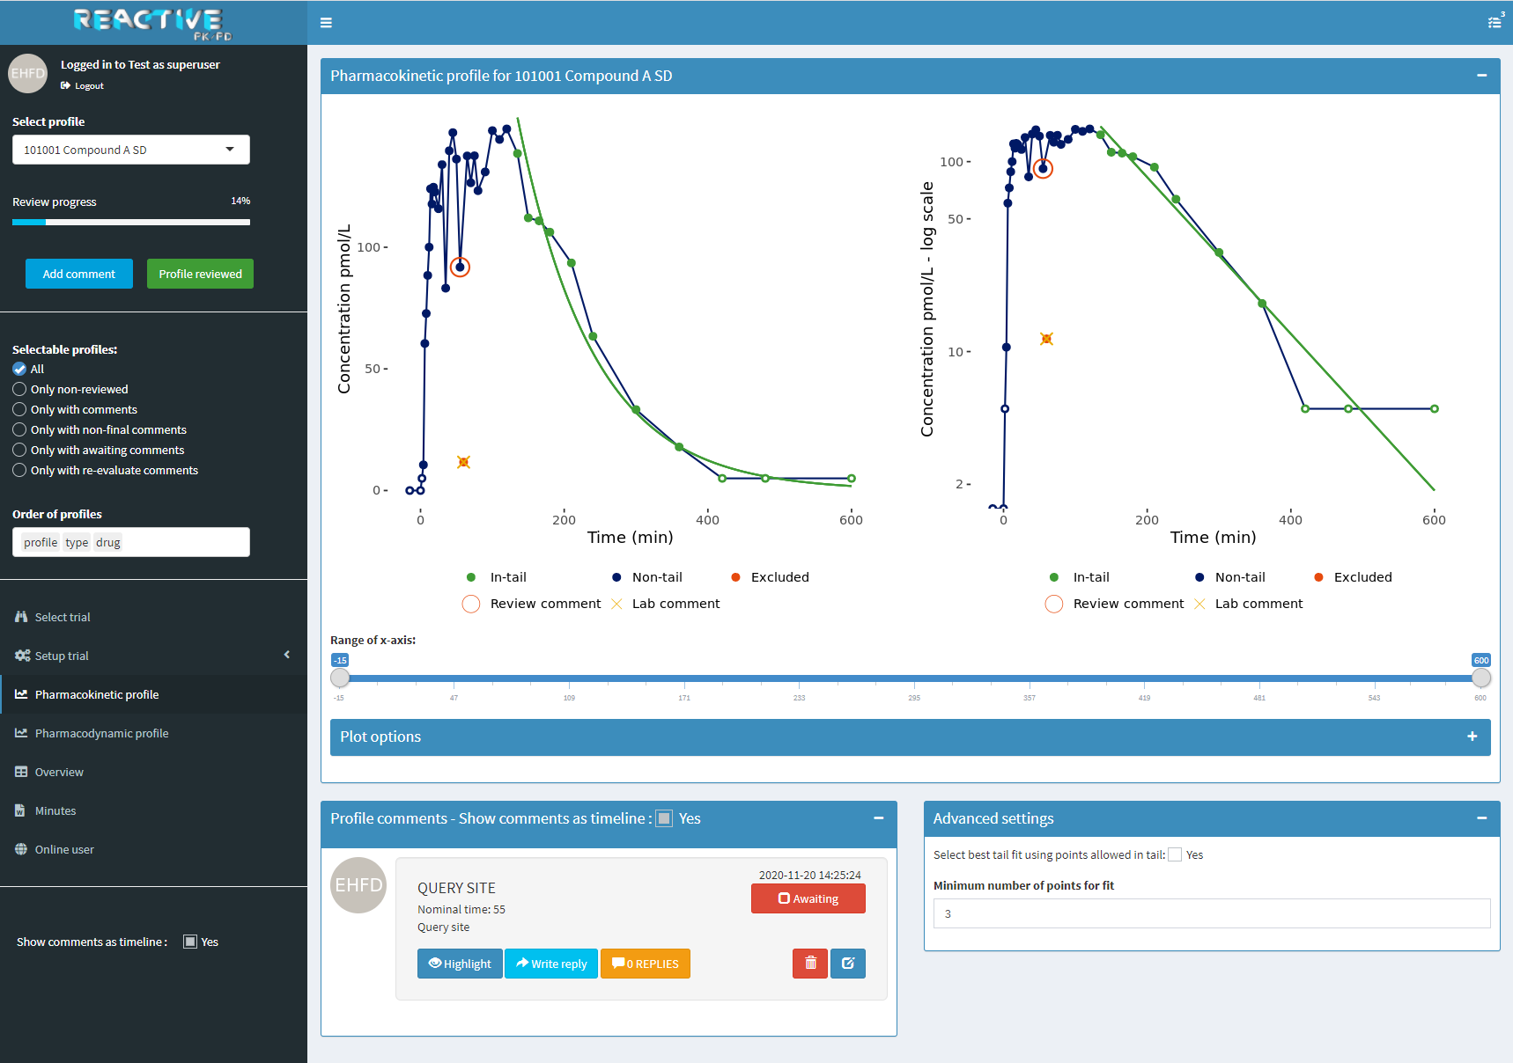
The display
Review progress
The main view
Left plot is in original scale
Right plot is in logarithmic scale
You can change the range of the x-axis by the slider bar
‘Plot options’ gives further specifications for the plot shown
The left pane
The PK profile will be shown in the main view by choosing a specific profile through ‘Select profile’
If you ever get lost in the tool go to ‘Pharmacokinetic profile’ or ‘Select trial’
Advanced settings
Only available for superusers
Gives the option to explore other potential tail fits using an algorithm to choose data points in tail among those with tail flag equal to 'Y’. The algorithm chooses data points backwards based on 𝑅^2 with a default of minimum 3 points
Profile comments
In this pane you can see the current comments for the PK profile choosen

Slide 17
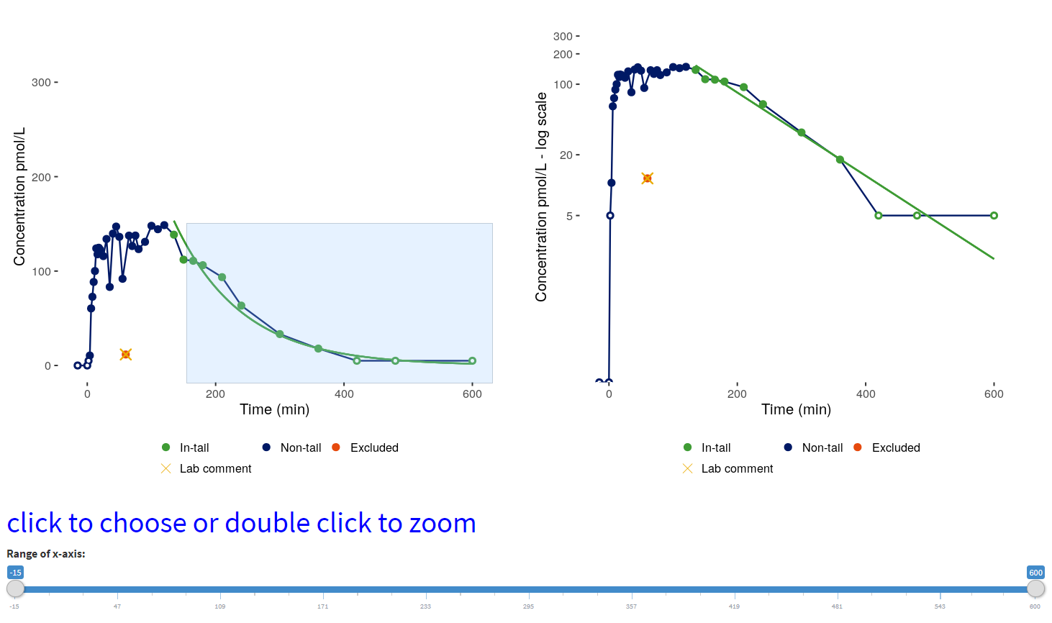
Select and zoom
Zoom
Mark the relevant area and double-click to zoom
To zoom out double click elsewhere in the plot
Select point(s)
Double click on a point to select it → double click on another point to further select this
Select multiple points by marking the area and click within the box
Selected points will be enlarged
To deselect points double click elsewhere in the plot

Slide 18
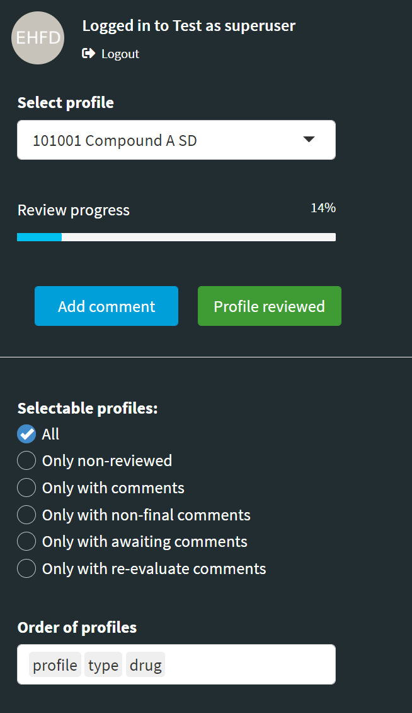
Using the tool
Select profile
For your individual reviews it is recommended to review the profiles from the start to end and skip to the next one by the use of the ‘Profile reviewed’ button. Then you only need step 2 and 3
Repeat until you’ve reviewed all available profiles
1
Add comment
Whole profile
Have no points marked and click ‘Add comment’
Single point(s)
Mark the points and click ‘Add comment’
1
2
2
3
Profile reviewed
Mark that you have reviewed the profile by clicking ‘Profile reviewed’
By pressing this button you will be taken to the next profile in line even though that you already have reviewed the profile
3

Slide 19
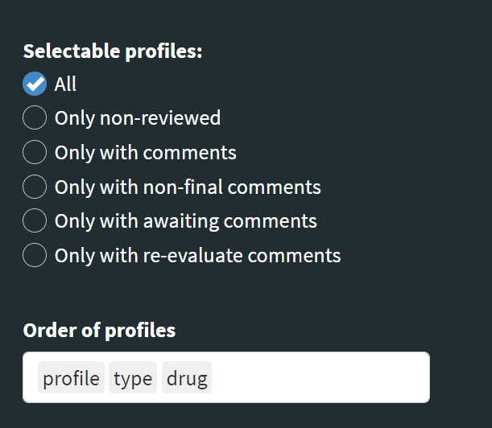
Selectable profiles and ordering
Selectable profiles
Subset the profiles that can be selected in ‘Select profile’. See here.
For example by only choosing the non-reviewed profiles.
For your individual reviews it is recommended to choose 'Only non-reviewed' or 'All’ and review the profiles from the start to end and skip to next profile by the use of the ‘Profile reviewed’ button, as described here.
Select profile order
Select in which order you want to review the profiles.
Delete what is in the box and then fill with for example:
‘type profile drug’ to sort based on ‘type’, then ‘profile’ and then ‘drug’.
'profile' is a variable containing the unique profile IDs available in 'Select profiles'. See here.
'type' is an optional variable. For a MD trial, it could be a variable indicating 'FD' for first dose and 'SS' for steady state.
'drug' is an optional variable used to indicate the treatment/compound related to each profile.
Notice, as 'type' and 'drug' are optional they may not always be included.

Slide 20
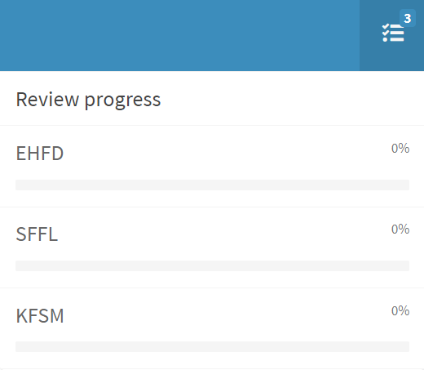
Review progress
Review progress
Each user is identified by their Novo initials
Each individual users review progress are shown in percentage based on the number of available profiles
The progress bar updates when the 'Profile reviewed' button is pressed. See here.

Slide 21
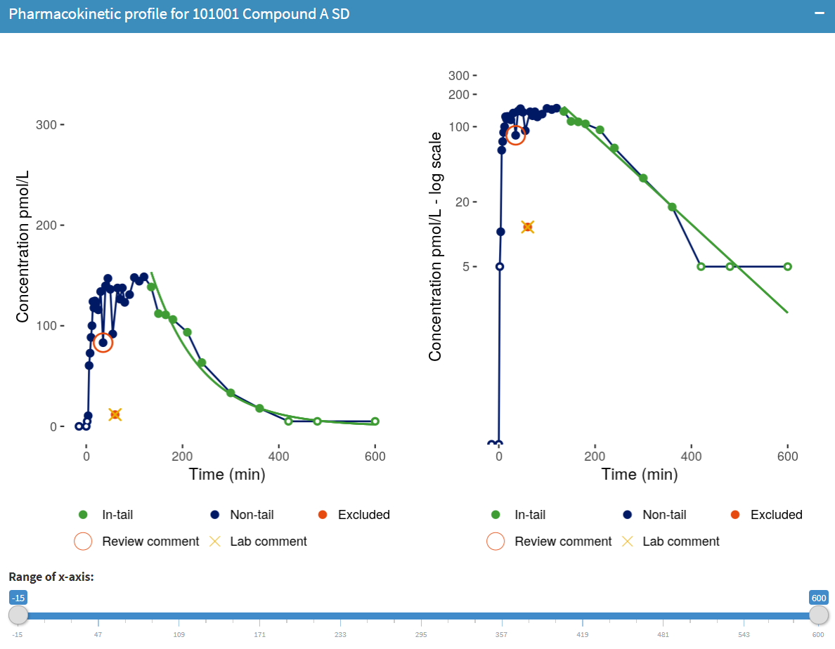
The main view
Left plot: original scale
Right plot: logarithmic y-axis but with the same unit as the left plot
X-axis: time, unit is data driven
Y-axis: concentration, unit is data driven
Notice by default the ranges of both the x- and y-axis are aligned for profiles with same 'type' and 'drug'. See here.
1
3
1. Points with review comments
4
3. Points with values < LLOQ
2
2. The cross indicates a point with a lab comment and red points are excluded points
4. Tail fit and data points included in the tail fit estimation

Slide 22
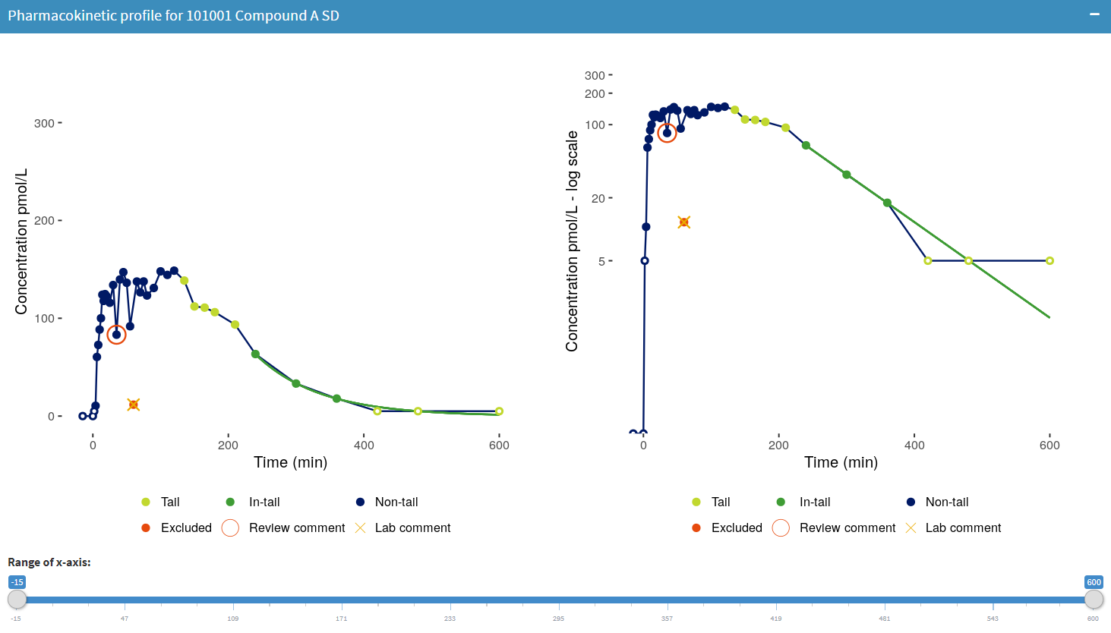
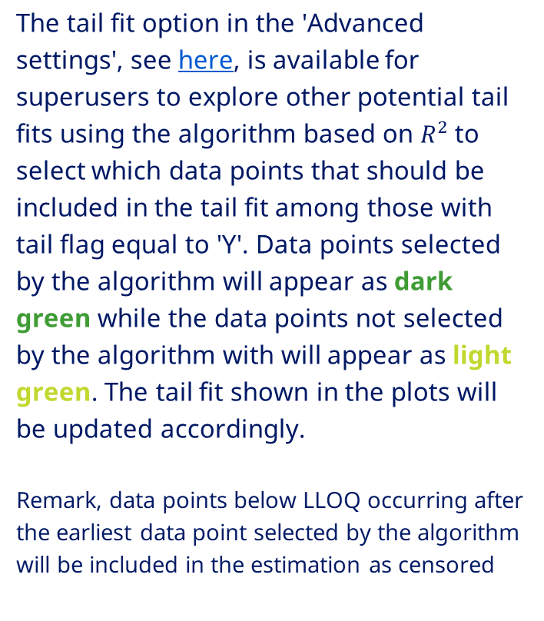
Exploration of tail fit
The tail fit option in the 'Advanced settings', see here, is available for superusers to explore other potential tail fits using the algorithm based on $R^{2}$to select which data points that should be included in the tail fit among those with tail flag equal to 'Y'. Data points selected by the algorithm will appear as dark green while the data points not selected by the algorithm with will appear as light green. The tail fit shown in the plots will be updated accordingly.
Remark, data points below LLOQ occurring after the earliest data point selected by the algorithm will be included in the estimation as censored

Slide 23
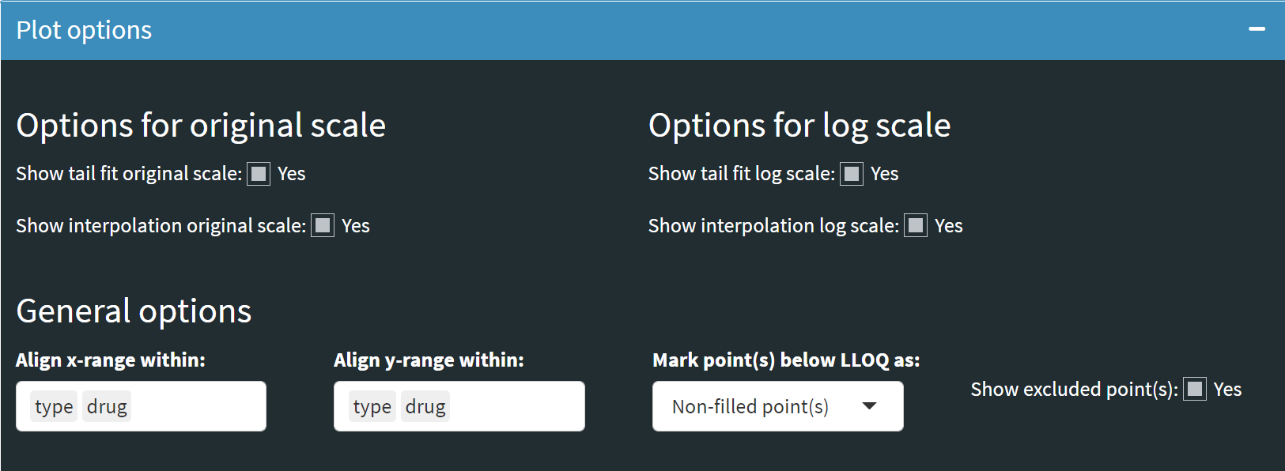
Plot options
‘Show tail fit original/log scale’
Option to show tail fit for both original and log scale plot - this is set to yes as default
‘Show interpolation original/log scale’
Option to connect the data points with straight lines - this is set ot yes as default
‘Align x/y-range within’
Option to align the x- and y-axis across profiles based on the optional variables 'type' and 'drug'. By default both 'type' and 'drug' will be used to align in case they are available. No alignment will be done if the option is left blank. Further details about 'type' and 'drug' are described here.
‘Mark point(s) below LLOQ as’
Option to mark point(s) below LLOQ as non-filled points or with vertical lines - non-filled points are used as default. For the vertical line option, the lines will go from LLOQ to 0 in the original scale plot, and from LLOQ to minus infinity in the log scale plot.

Slide 24
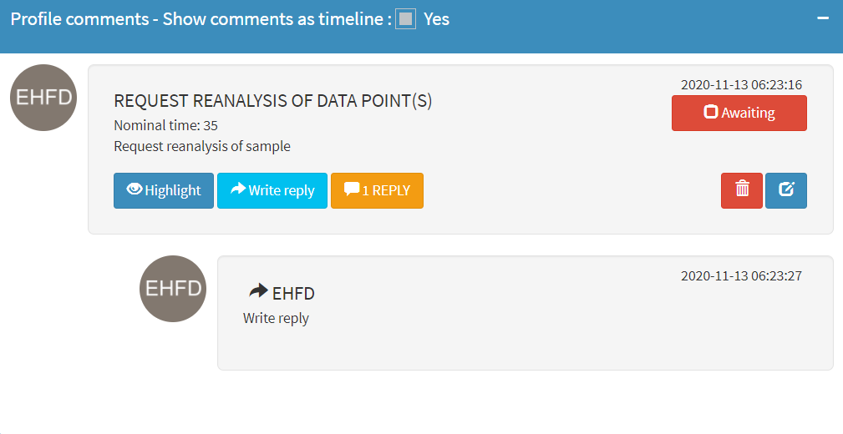
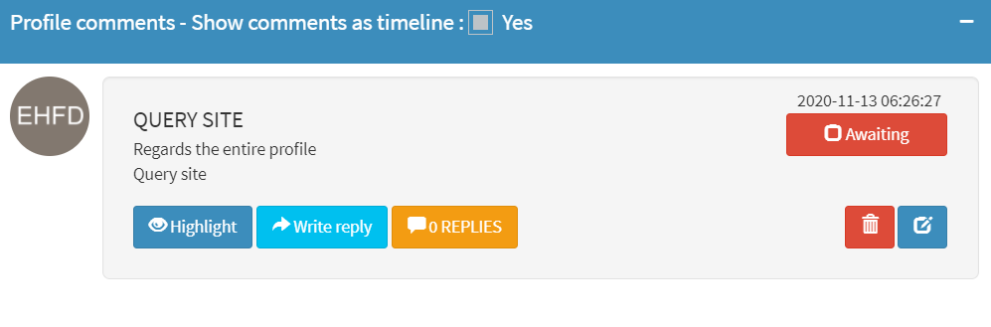

Profile comments
Categories when adding comments for the whole profile:
Excl. profile
Baseline correct profile
Request reanalysis of profile
Query site
Other
Some categories contains prespecified comments but it is possible to write your own
Status of the comment
Delete and edit comments
Categories when adding comments for selected point(s):
Excl. data point(s)
Excl. data point(s) from tail fit
Request reanalysis of data point(s)
Query site
Other
Some categories contains prespecified comments but it is possible to write your own
Highlight points that the comment concerns
Write a reply by selecting ‘write reply’
Toggle replies on and off by pressing 'Replies'
No comments added

Slide 25
Creating minutes

Slide 26
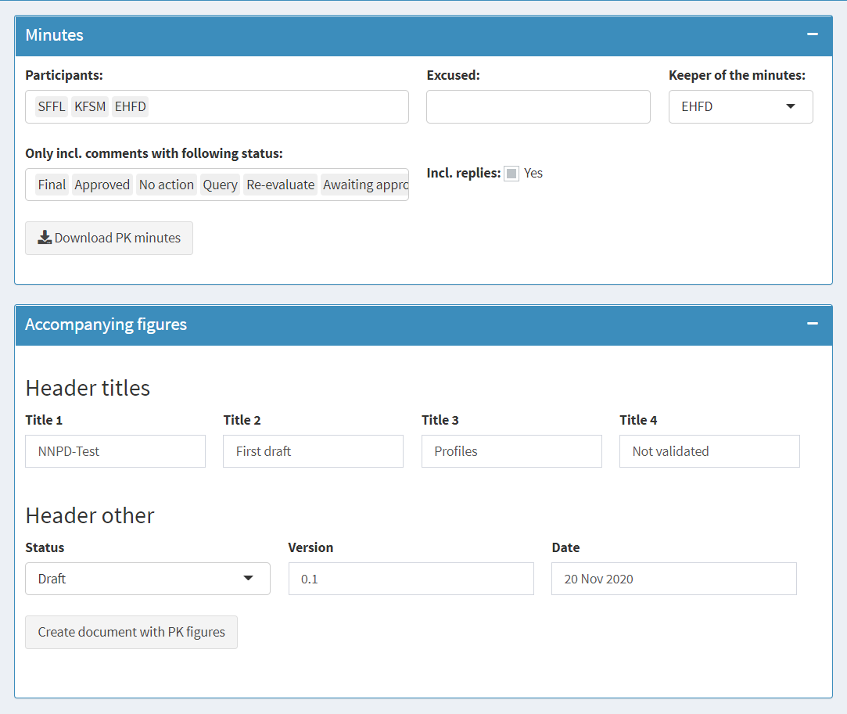
Creating minutes
Select ‘Minutes’ in the left pane
Option to include comments with a specific status and to include replies
‘Participants’ is set to all superusers and users as a default. Tag excused people in ‘Excused’
Download the PK minutes as a word document with the tables of comments.
Write titles that will be shown in the header of the word document created
Specify the ‘Status’, ‘Version’ and ‘Date’, which will be shown in the header of the word document created
Create accompanying figures. The comments and replies are included according to the options choosen in ‘Minutes’
Notice: It can take minutes to create this document and can potentially freeze the app, so check if any other users are online before doing so in the ‘Online user’ tab in the left pane

Slide 27
Download trial data

Slide 28
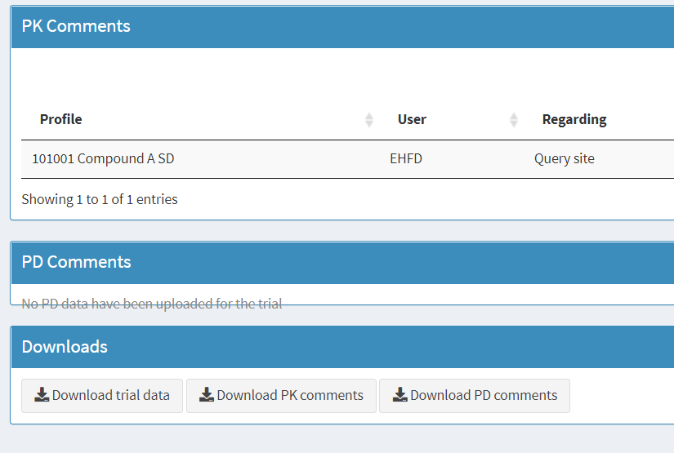
kd
Choose ‘Overview’ in the menu bar
Select ‘Download trial data’ to download a zip file containing allavailable trial data on the app
It is recommended to do this after each review round as a backup
To upload a trial as a zip file to the app select ‘Trial info’ in the menu bar and the tab ‘Upload PKPD zip file’ will appear
Select ‘Download PK comments’ to download all PK related comments in a CSV file
Select ‘Download PD comments’ to download all PK related comments in a CSV file

Slide 29
Delete trial

Slide 30
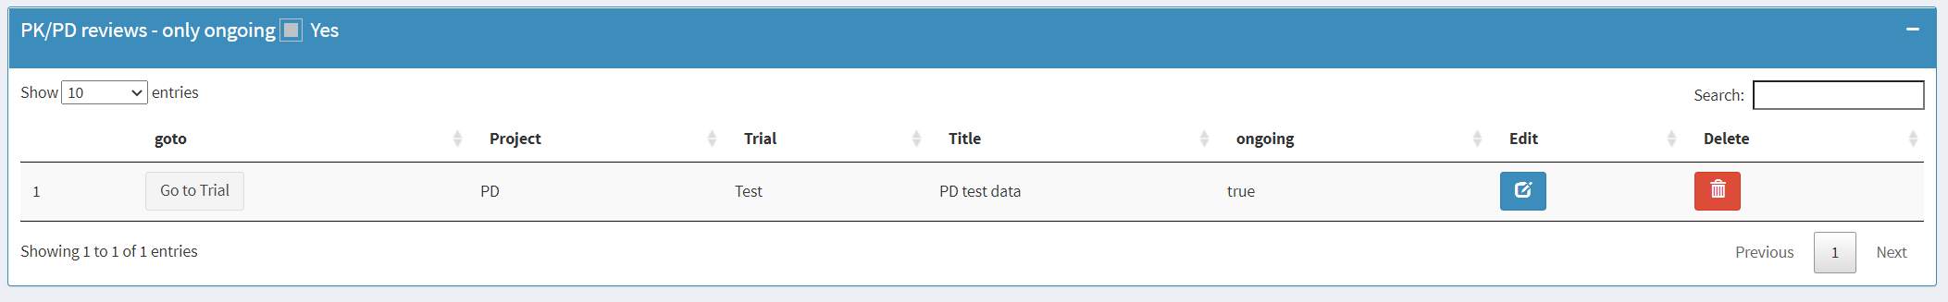
When the CTR is final for a trial the trial must be deleted from the app. Before doing so we recommend to download the trial data. See here

